Slide 1

THE TRAVELING SALESPERSON PROBLEM(TSP) Presentation:
COURSE: BACHELOR IN INFORMATION TECHNOLOGY
UNIT : ARTIFICIAL INTELLIGENCE
UNIT SUBTOPIC: TSP
LECTURER: DR.PATRICK GIKUNDA
DATE: 27th May 2025
GROUP MEMBERS: REG. NUMBER ROLE PLAYED
MUTHUNGA JUSTUS C025-01-1198/2019 Group Leader & 1st Presenter
ELISHA CHERUIYOT C025-02-0879/2022 Distance Matrix Champ
DAVID MWANGI C025-01-0611/2023 Brute Force Developer
SIMON ONDIEKI C025-01-0686/2023 Visualizations
EDWIN WERU C025-01-2138/2023 Optimization of the Routes
VALARINE CHERONO C025-01-0660/2023 Conclusions and Recommendations
CECILIA WANJIKU C025-01-0644/2023 Documentation Writer
AGAPE WANJIKU C025-01-0648/2023 Final Editing & QA
DON CARLOS JOHN C025-01-0685/2023 Time & Distance Research
SHADRACK KIPLELGO C025-01-0680/2023 Comparison and Complexity

Slide 2

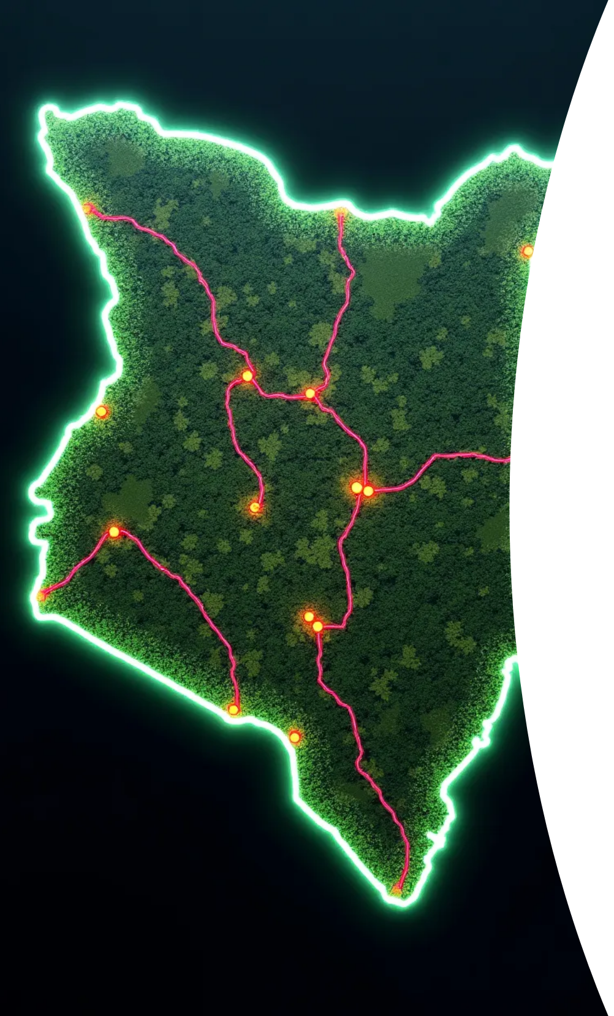
What is the Traveling Salesperson Problem (TSP)?
:
Presenter: Group Leader
Imagine you're a scientist in a Tea manufacturing Company and are asked to find the best optimal route for the company’s salespeople tp sell through the several cities. In this case Nyeri, Meru, Nandi, Kericho and Nakuru.
You want to start at your home city, Nairobi, and visit every other city exactly once, and then return home.
The Big Question: What's the shortest possible path you can take?
This is the Traveling Salesperson Problem (TSP)! It's a famous challenge in computer science and math.

Slide 3
Why is TSP Important?
Logistics & Delivery: Planning routes for Amazon, FedEx, food delivery.
Transportation: Optimizing bus routes, flight paths.
Manufacturing: Drilling holes in circuit boards efficiently.
Even everyday life: Planning a road trip!

Slide 4
Our Goal Today:
Understand a simple way to solve the TSP using Python.
See how our code finds the shortest route for a set of cities in Kenya!
Significance of finding
the BEST Route
Insights
Understanding TSP aids organizations in optimizing resource management for better profitability.
Save fuel and time
Ensure smooth and quick delivery
Support planning for real sales trips
Minimize travel distance or cost

Slide 5

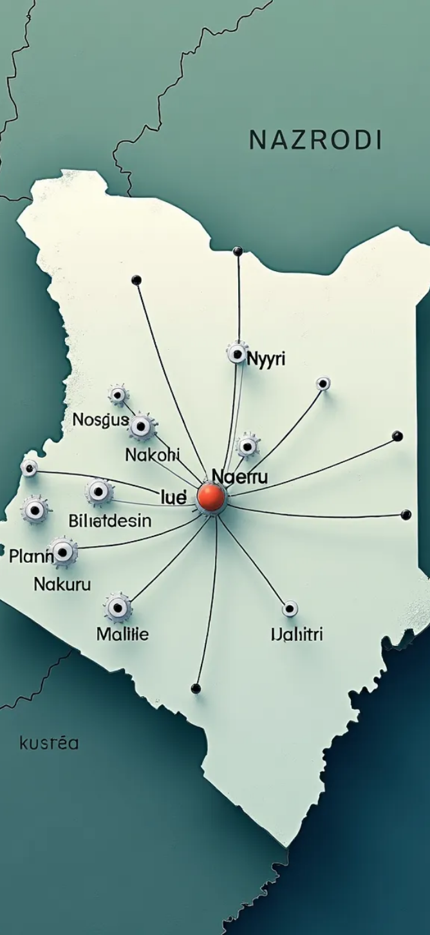
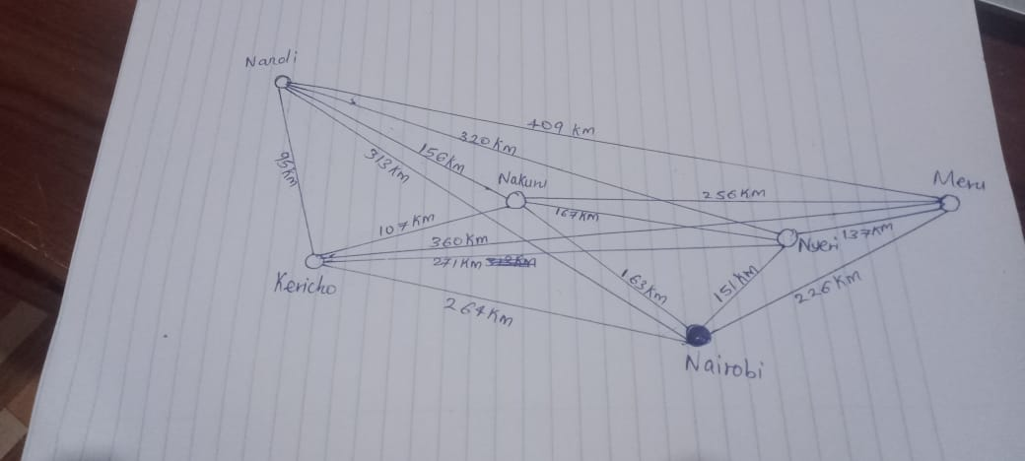

Location Data and Distance Matrix:
Presenter: Elisha Kiprop
The first step in solving the Traveling Salesman Problem (TSP) is compiling accurate location data for the regions involved. The key locations for our analysis are Nairobi (starting point), Nyeri, Meru, Nandi, Kericho, and Nakuru. This information allows us to create a distance matrix, a table that shows the distance between each pair of locations. For example, the distance from Nairobi to Nyeri or from Nyeri to Kericho is essential in calculating the overall travel path and time for salespeople.
1
Accurate Location Data
Compile location data for regions involved.
2
Key Locations
Nairobi (starting point), Nyeri, Meru, Nandi, Kericho,
Nakuru.
3
Distance Matrix Creation
Created table showing distances between each pair
of locations.(NEXT PAGE).

Slide 6
REAL WORLD DISTANCE MATRIX
From/To | Nairobi | Nyeri | Meru | Nandi | Kericho | Nakuru
Nairobi | 0 | 150 | 225 | 310 | 270 | 160
Nyeri | 150 | 0 | 130 | 350 | 310 | 180
Meru | 225 | 130 | 0 | 420 | 400 | 210
Nandi | 310 | 350 | 420 | 0 | 120 | 200
Kericho | 270 | 310 | 400 | 120 | 0 | 140
Nakuru | 160 | 180 | 210 | 200 | 140 | 0

Slide 7



Brute Force Method
Presenter: David Mwangi
Computational Feasibility
The feasibility is limited by the number of locations; for five locations, 120 routes are possible.
2
Overview
The brute force method calculates all possible routes to find the shortest one.
1
Advantages and Disadvantages
3
Reliable for exact results but impractical with more locations.

Slide 8
How Our Code Thinks (The "Brute Force" Method)
Brute Force is like trying every possible route until we find the shortest one.
✅ Step-by-Step:
List All Cities Nairobi → Nyeri, Meru, Nandi, Kericho, Nakuru → Back to Nairobi
Generate Every Possible Route There are 120 combinations (5! = 120).
Calculate Distance for Each Route Add up the kilometers in each full round trip.
Choose the Shortest One The route with the lowest total distance is our best option.

Slide 9
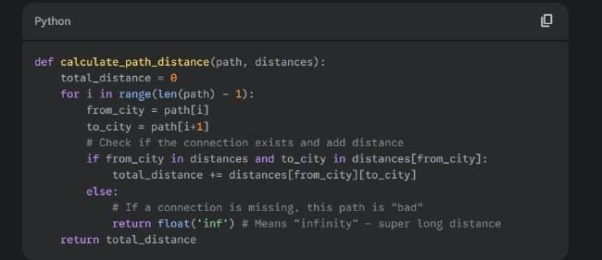
BRUTEFORCE CODE IMPLEMENTATION SAMPLE

Slide 10



Branch and Bound Method
Presenter: Muthunga Justus
The Branch and Bound method is an efficient optimization technique that systematically explores the solution space while pruning paths that cannot lead to a better solution. By calculating lower bounds on the cost of partial routes, this method significantly reduces the number of potential solutions compared to the brute force approach. By applying this strategy to our route optimization, we can retain the accuracy of results while improving overall performance and reducing computation time, particularly beneficial in practical applications with many locations.
Introduction
Cost Pruning
Practical Applications
An efficient optimization technique that explores solution space.
Prunes paths that cannot lead to better solutions, reducing complexity.
Beneficial in applications with multiple locations, improving performance.

Slide 11
.
How Our Code Thinks (Branch and Bound Method)
Step-by-Step Mental Map of the Code:
Start at the Base City (Nairobi) The algorithm begins at Nairobi and considers all possible cities that can be visited next.
Create a Decision Tree It builds a tree of choices:
Each branch represents a possible path
Each level represents a step deeper into the trip
Estimate the Lowest Possible Cost (Bound) For each partial route, the algorithm estimates:
"What’s the cheapest this path could become if we continue?“
Ignore Unpromising Paths (Prune) If a partial path already costs more than a previously found full route: ❌ That entire branch is abandoned! This saves time by not exploring every option (unlike brute force).
Repeat Until Best Route Found It continues building and cutting branches until only the shortest possible full route remains

Slide 12
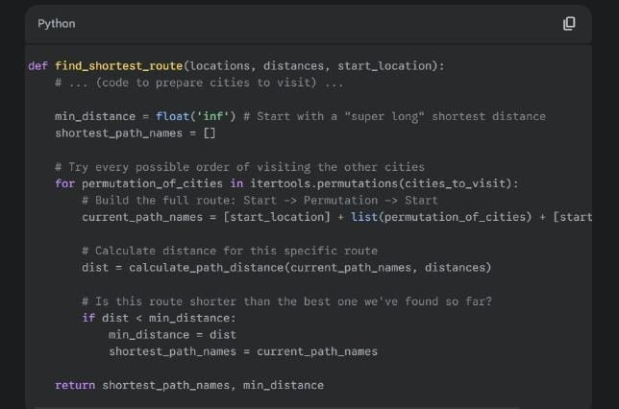
BRANCH AND BOUND CODE SAMPLE:

Slide 13




Other Optimization Techniques
Presenter: Simon
Various optimization methods exist beyond brute force and Branch and Bound, including Genetic Algorithms, Ant Colony Optimization, and Neural Networks. Each of these methods brings unique strengths and can enhance optimization strategies that leverage multiple techniques for better solutions.
Ant Colony Optimization
Utilizes ant behavior to discover optimal paths, effective for TSP variants.
Neural Networks
Genetic Algorithms
Deep learning approaches for approximating solutions, requiring extensive data.
Mimics natural selection for robust solutions in large datasets.
2
1
3

Slide 14




Visualization of the Routes
Presenter: Edwin
Visual representation of the calculated route is essential for understanding its practicality. Mapping the optimal route on a geographical interface, such as Google Maps, allows for real-world validation of the distance and estimated travel times. This visualization indicates how salespeople can navigate through the selected cities efficiently, enabling strategic planning for operational logistics and identifying potential challenges on-the-ground, such as traffic or road conditions.
2
Real-world Validation
Importance of Visualization
1
3
Strategic Planning

Slide 15
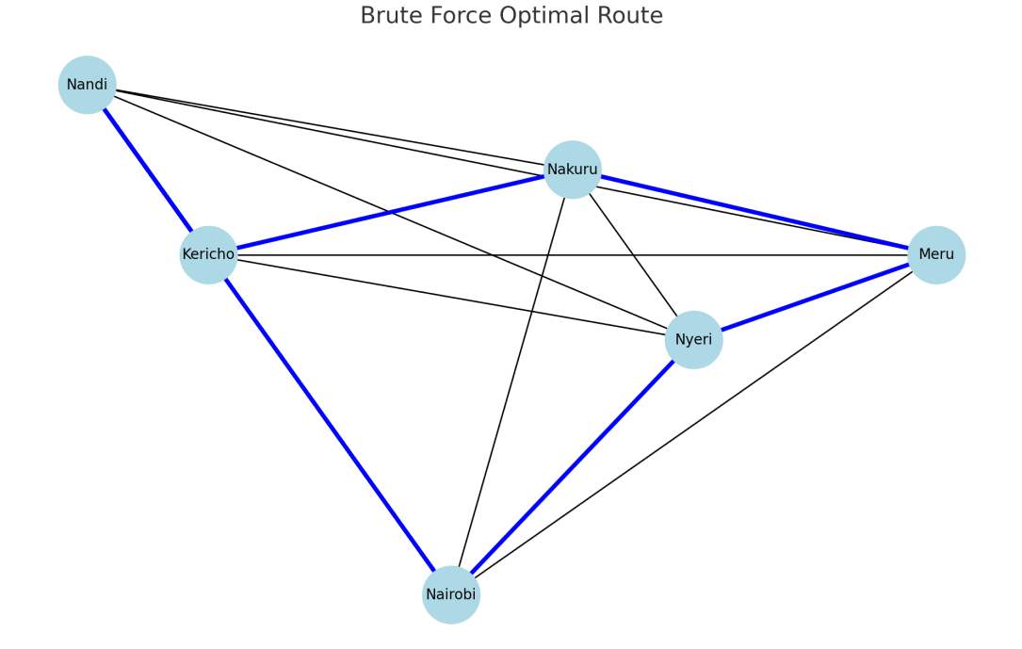
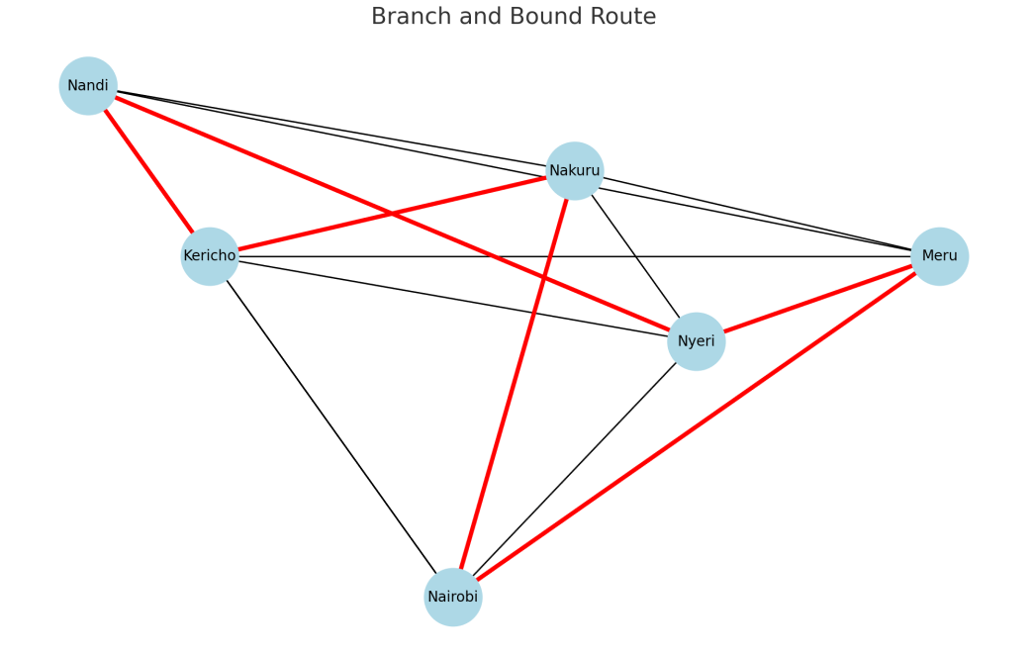
BRUTE FORCE ROUTE
BRANCH AND BOUND ROUTE

Slide 16
THE RESULT!
Shortest Route: Nairobi -> Nandi -> Kericho -> Nakuru -> Nyeri -> Meru -> Nairobi
Total Distance: 1045 km

Slide 17




Complexity and Performance Comparison
Presenter: Shadrack K.
The comparison of complexity and performance between brute force and Branch and Bound methods shows the critical importance of algorithm selection depending on the scale of the routing problem. While the brute force approach is factorial and quickly becomes impractical for larger problems, the Branch and Bound method is polynomial and performs well with up to 10 locations. Making informed choices on algorithms can lead to significant savings in time and costs.
Brute Force Method
Branch and Bound Method
Performance Comparison
Complexity is factorial (O(n!)), unsuitable for larger problems.
Operates with polynomial complexity, efficient for up to 10 locations.
Strategic choice essential for time and cost savings.

Slide 18
CONT. COMPARISON B2N THE TWO METHODS:
Method | Time Complexity | Accuracy | Speed | Scalability | Best Use Case
Brute Force | O(n!) | ✅ 100% | ❌ Slow | ❌ Poor | Very small problems
Branch and Bound | O(n²·2ⁿ) | ✅ 100% | ✅ Fast | ✅ Medium | Medium-sized problems
IN this case : Both methods provide optimal solutions, but Branch and Bound is a smarter, more scalable choice for real-world use.

Slide 19



Real World Cost Model
Presenter: Don Carlos John
In the real-world application of the optimal route, a cost model can be created by factoring in fuel costs, time taken, and vehicle depreciation. For example, if we estimate fuel costs at $3 per gallon and average miles per gallon for the vehicle used, total travel costs can be calculated based on the optimal routing distances. This model helps provide a comprehensive overview of operational costs, enabling better financial forecasting and budgeting for the company.
Cost Factors
Travel Cost Calculation
Financial Overview
Using estimated fuel costs and average mileage.
Providing insights for operational costs and budgeting.

Slide 20
Example Calculation
Let’s assume the following:
Fuel cost = KES 20 per km
Distance traveled = 850 km
Driver allowance = KES 200/hour
Travel time = 18 hour
Fuel: 850 km × 20 = KES 17,000
Driver: 18 hr × 200 = KES 3,600
Maintain: 850 km × 5 = KES 4,250
Total Cost: = KES 24,850
Optimizing the route isn’t just about saving distance—it's about saving real money and time.

Slide 21



Conclusion and Recommendations for Route Optimization
Presenter: Valary Cherono
Invest in Routing Software
2
Utilize advanced algorithms for improvement.
Adopt Branch and Bound
1
Efficient handling of route complexities.
Regular Route Reviews
3
Adapt to changes in business dynamics.

Slide 22




Lessons Learned from TSP Analysis
2
Advanced Algorithms
Drive significant benefits in decision-making.
Strategic Route Planning
1
Enhances operational efficiency.
Continuous Evaluation
Adapt sales strategies to market changes.
3

Slide 23

Q &A:
Q1. Why did you use Brute Force and Branch and Bound?
✅ A: Brute Force gives us a full solution space and a guaranteed optimal path — it's best for accuracy but not scalable.
Branch and Bound: W offers a more efficient search, using bounds to skip unnecessary paths — it's a good tradeoff between accuracy and performance.
Q2. What was the most challenging part of this project?
A: Visualizing and simulating real-world data in a simple Python environment while keeping the logic understandable for everyone. We also had to balance technical accuracy with presentation clarity.
Q3.What would you do if you had 20 towns instead of 5?
A: Brute Force would be too slow. We would shift to smarter heuristics like Ant Colony Optimization, Genetic Algorithms, or use Google OR-Tools to handle large-scale routing efficiently.
THANK YOU.

